Slide 1

A Project Report On
AUTOMATED TELLER
MACHINES
By
Batch: 2021 – 6522
Center:Thane
Under the Guidance of,
Chittaranjan Ghosh.
Technical Trainer
EduBridge
(School of coding)

Slide 2
Introduction:
The software ATM version1.0 is to be developed for Automated Teller Machines (ATM). An automated teller machine (ATM) is computerized telecommunications device that provides a financial institution's customers a secure method of performing financial transactions, in a public space without the need for a human bank teller. Through ATM, customers interact with a user-friendly interface that enables them to access their bank accounts and perform various transactions.
Modules:-
· Admin Module
· User module
I have developed this Application in Mavean and MySQL.

Slide 3
This document applies to Automated Teller Machine software ATM version1.0. This software facilitates the user to perform various transactions in his account without going to bank. This software offers benefits such cash withdrawals, balance transfers, deposits, inquiries, credit card advances and other banking related operations for customers. It also allows the administrator to fix the tariffs and rules as and when required.
User Module- User can access the ATM System simply.User can easily login by their id and can withdraw money anytime anywhere ,and also deposit and can change password too.
Software Requirements:
Editor: Core java
Back end: MySQL
Console: Display result on Console
Operating System: Windows 7/10

Slide 4
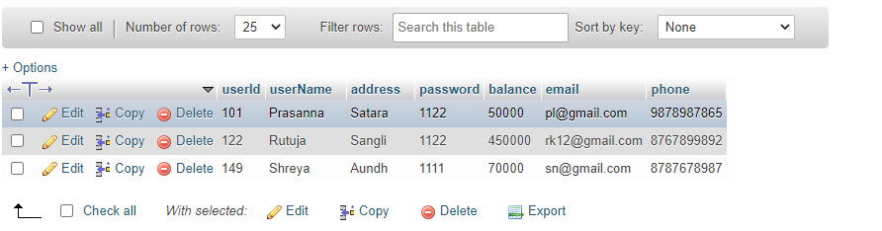
Data Dictionary

Slide 5
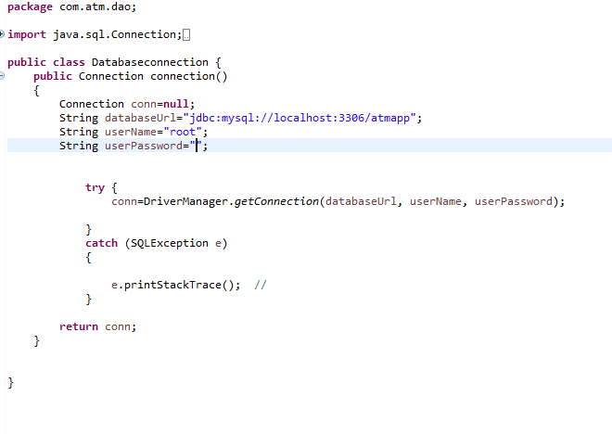
Code Screenshots:-
Database Connection

Slide 6
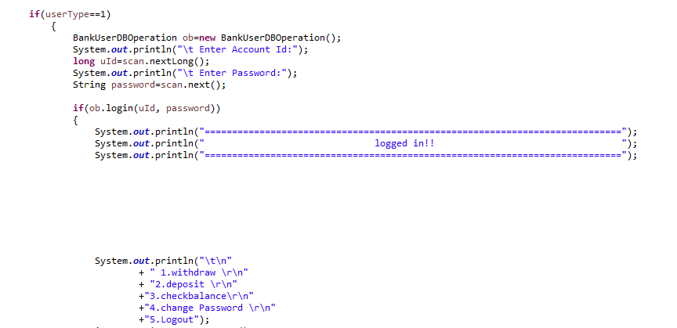
App.java

Slide 7
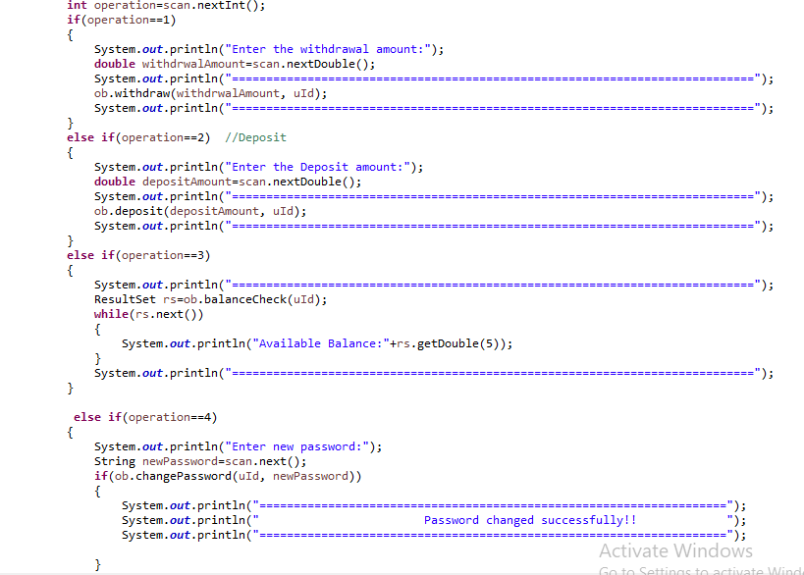
App.java

Slide 8
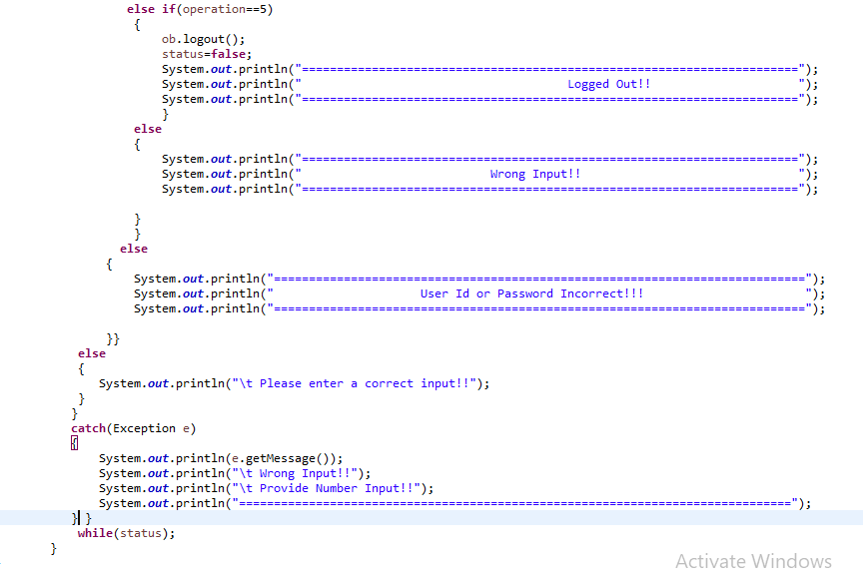
App.java

Slide 9
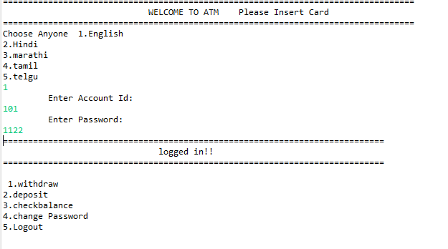
OutPut:-

Slide 10
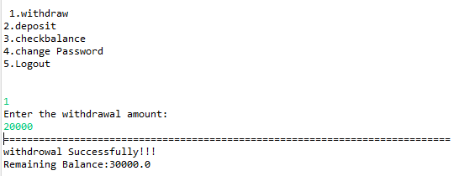
1.

Slide 11
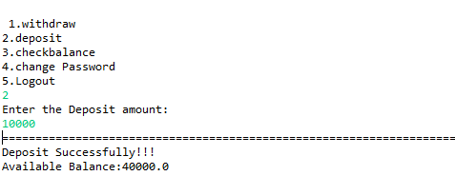
2.

Slide 12
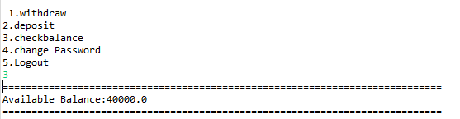
3.

Slide 13
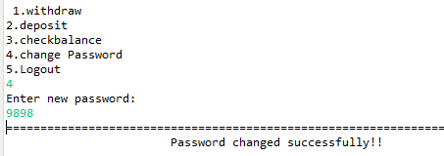
4.

Slide 14
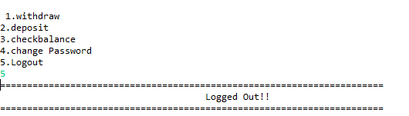
5.

Slide 15
THANK YOU

